Slide 1
Work Progress Update 10th June
By: Aryan Rajesh Aher

Slide 2
Data analysis work assigned by Hussein
Following the previous work one list was prepared in which times where temperature went overboard by 1 degree was marked. In another instance times were marked where temperature went overboard by 2 degrees were marked.
The following slides shows some sample images where these times were marked specifically in the plots.
It was again observed that after the implementation of the method by Hussein abnormal temperature instance were as low as 5-10 times in the duration of 10 months and in almost all cases it quickly returned within the bounds in couple of hours or so.

Slide 3
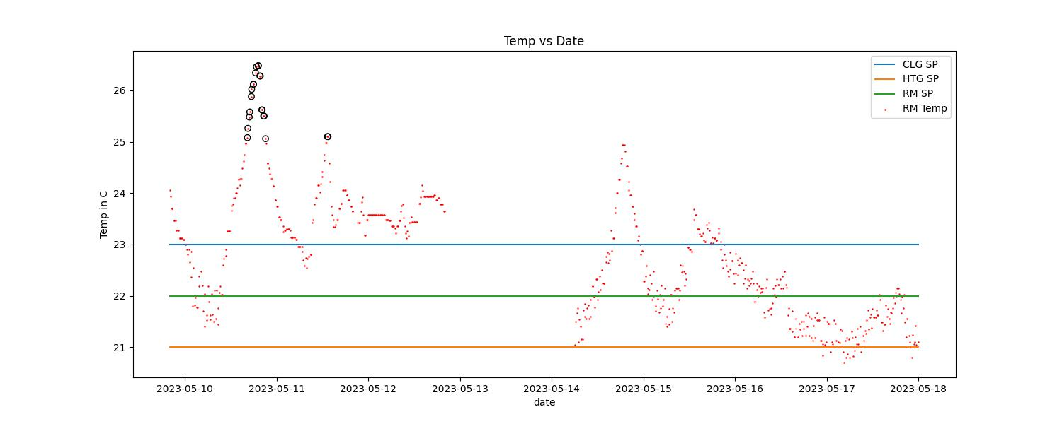
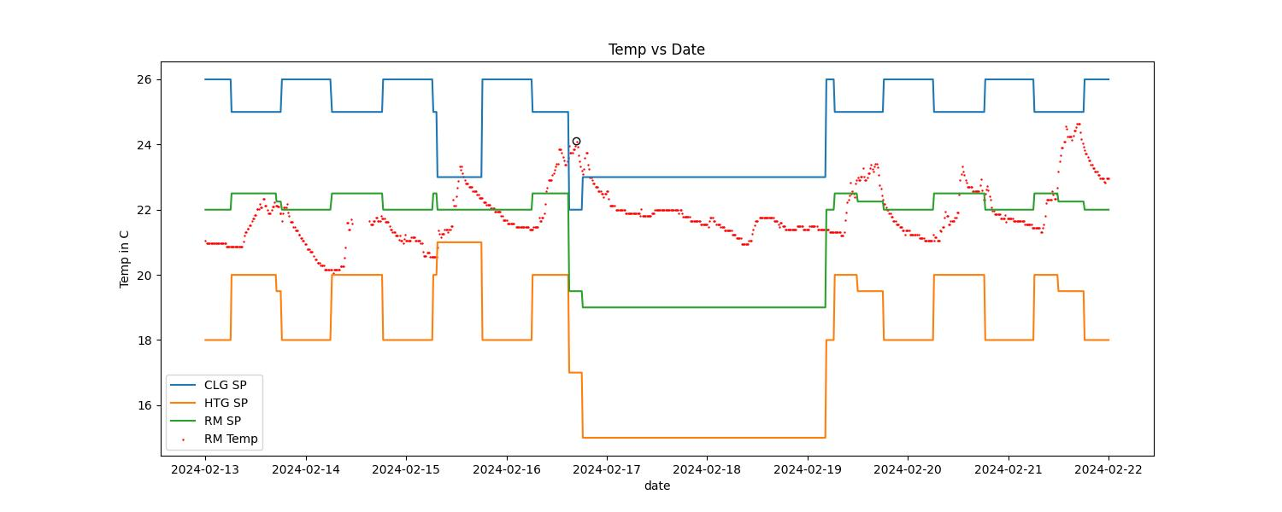
Room 1035_02

Slide 4
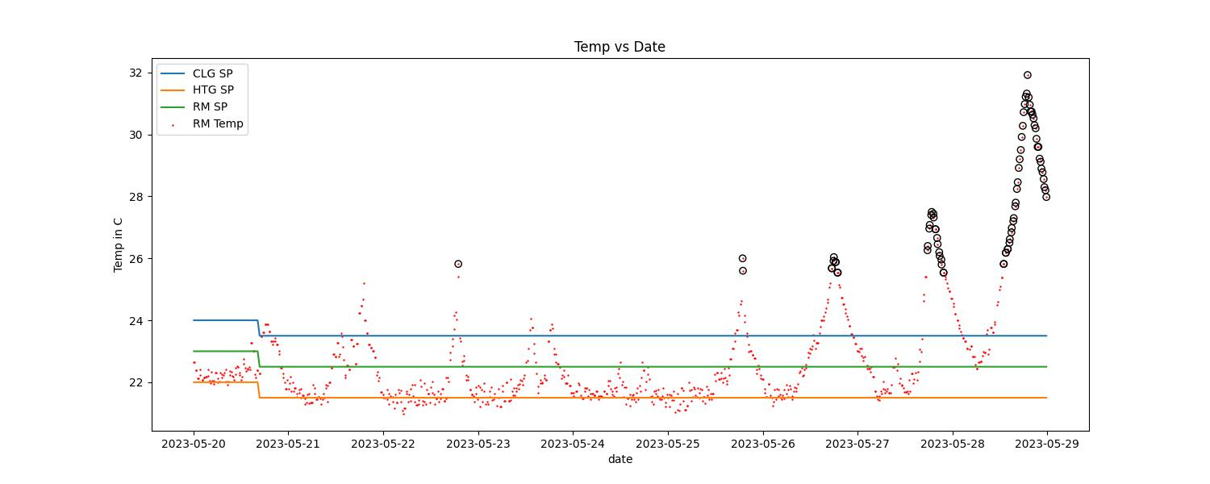
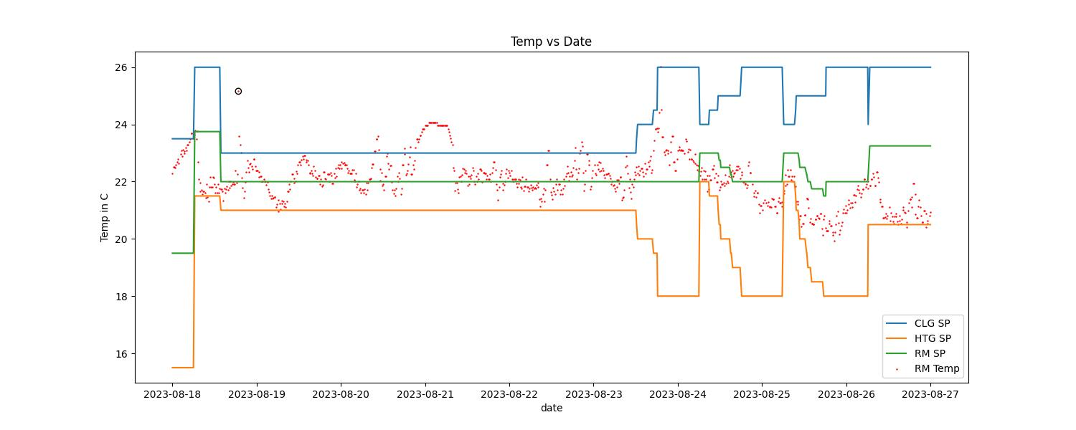
1035_01

Slide 5
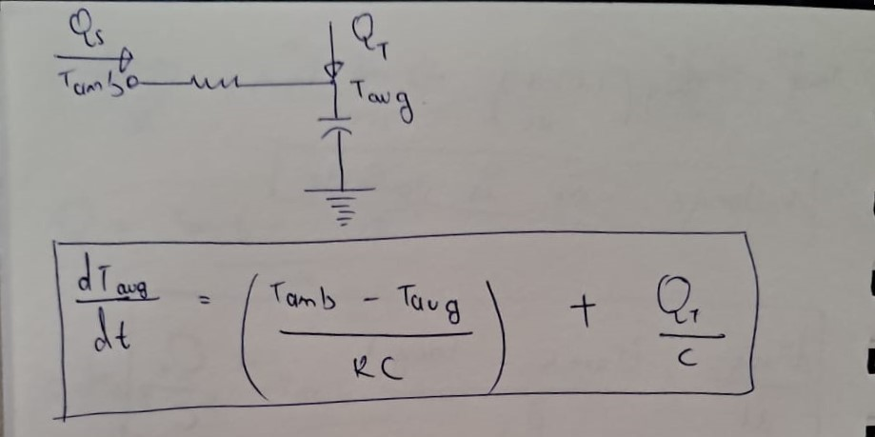
Updates on RC modelling: simplified model

Slide 6
Initial cleaning of data
The given data was cleaned thoroughly i.e. outliers were removed.
After removing unnecessary data, resampling followed by interpolation was done to ensure that data is at constant time intervals without any gaps.
The heat input to the system was calculated as the heat lost by the air.
Finally all of the cleaned, resampled and interpolated data was stored in a separate csv file.

Slide 7
Parameter fitting
Initially the data was trained to predict just the temperature at the next time step.
This method gave very less error (mae around 0.05 degrees) on the testing data but Aya suggested this would not work for the time series which is expected as it was trained to only predict the temperature at the next step of 5 mins.
Another method was employed which simulated the temperature for the whole duration and then fitted the data to get the value of R and C.
This method gave mae to be around 3 degrees. Aya told that this error was acceptable and also expected as we are making several assumptions on the model.

Slide 8
Challenges
Different solvers was employed to find the optimal R and C. Most of them gave an acceptable answer.
The issue is even if the error is low the order of magnitude of Resistance does not make sense for a physical setting. To solve this bounds were given to resistance value so that it comes within expectations but the solvers gave optimal answers which were equal to the bounds meaning the answer is lying on the boundary of the bound.
This means we are forcing the answer to come out that way rather than it coming out optimally.

Slide 9
Future Tasks
Figure out a direction to get a reasonable value of resistances.
Start working on the control aspects of the task.

Slide 10
Airport data work
Data as suggested by you and Sleiman and you were collected by me and aryan. I did it for 5 airports including Montreal, Munich, Heathrow, Beijing and Atlanta. For now I have collected the data in google docs. We still need to compile the whole data and send it to sleiman.
This is the link to the data that I collected.
Airport data

